Slide 1
Where do we go from here?

Slide 2
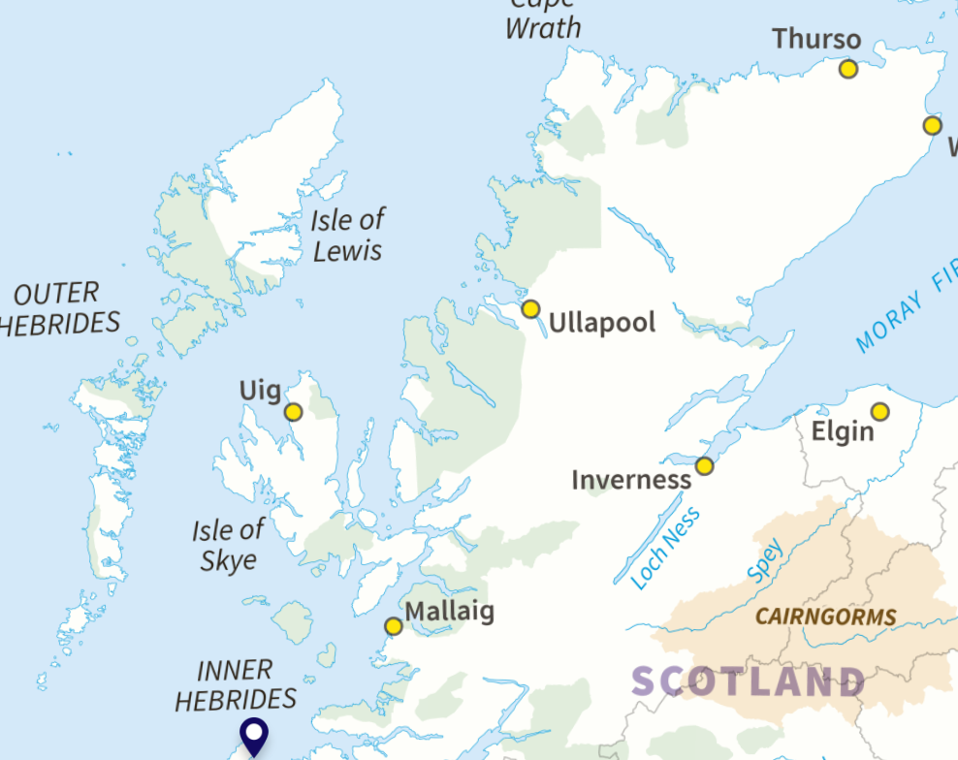
The Highlands & Islands

Slide 3
Where we come from…

Slide 4
To misquote JF Kennedy:
Ask not what your organisation can do for you.
Ask what you can do for your organisation

Slide 5
How can we help each other…
ARCH
NOSAS
Museums & Heritage Highland
Scottish Community Heritage Alliance
Many other trans-Highland organisations
Ask not…..

Slide 6
Our Problems
Volunteer recruitment and retention
Continuity, when leaders stand down or move on
Ageing issues – a success and a challenge
Use of technology, or unfamiliarity with
Geography – again, a challenge and a strength
Engaging with others – especially the young and “diverse groups”

Slide 7
Our Needs
A digital database for all our records – words, images, film
Help with technology – websites, facebook pages, digital storage, etc.
More opportunities like this to meet with others
Young(er) people
Develop creative solutions to current challenges

Slide 8
How can we collaborate more?
Do this again? Maybe yearly, or biannually
Learn from each other – eg one organisation hosting a training or information session for others
A Highland Heritage Forum – just online, or in person?
Link in with other organisations, eg Highland Environment Forum
Use current Highland-wide organisations – ARCH, SCHA, MHM, etc
Set up local heritage trails – for other heritage groups and for tourists

Slide 9
How can we help each other…

