Slide 1
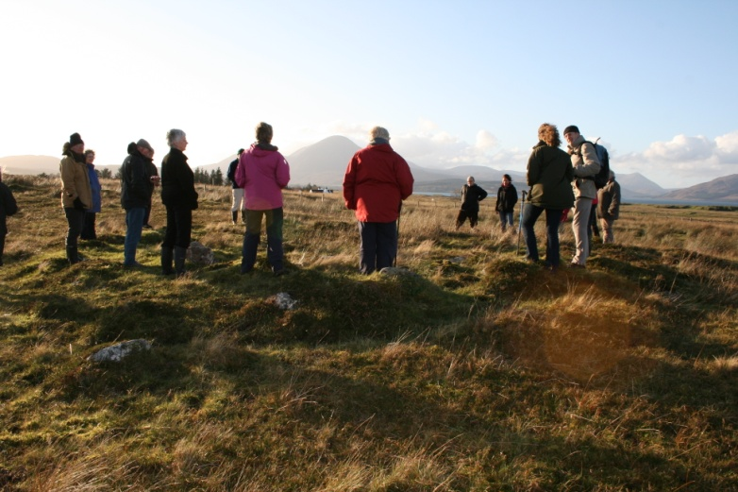
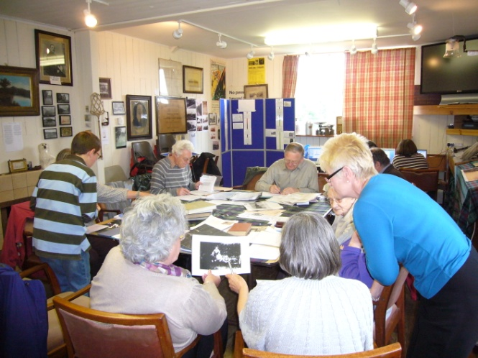
Exploring and Engaging People in the Community in their Heritage
Susan Kruse

Slide 2
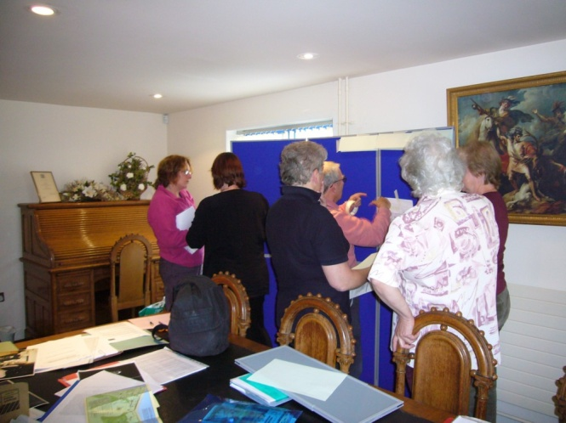
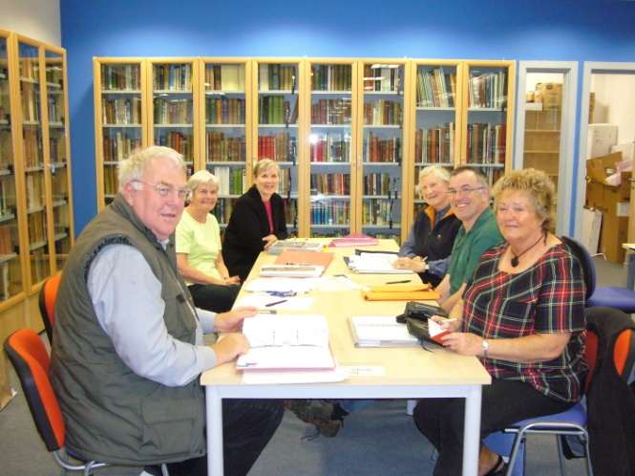
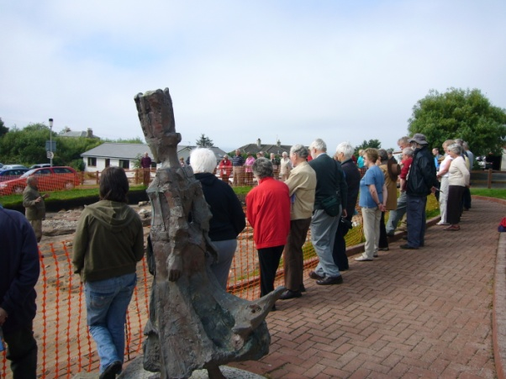
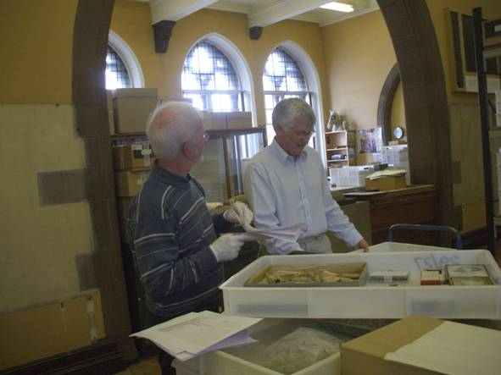
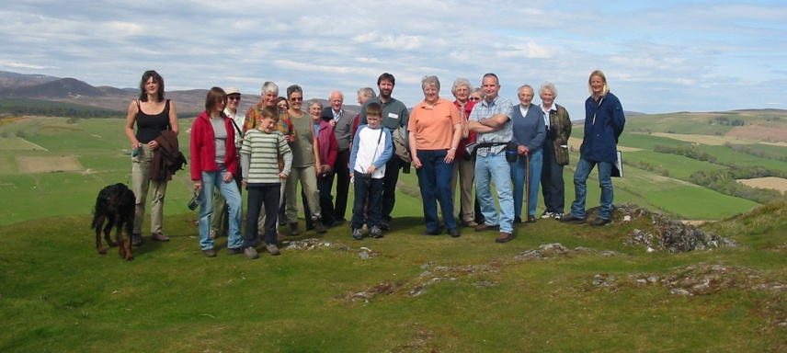
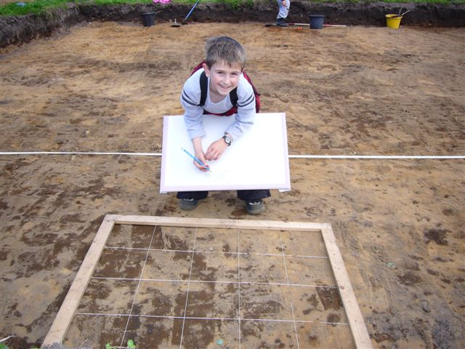
What is Community Heritage?

Slide 3
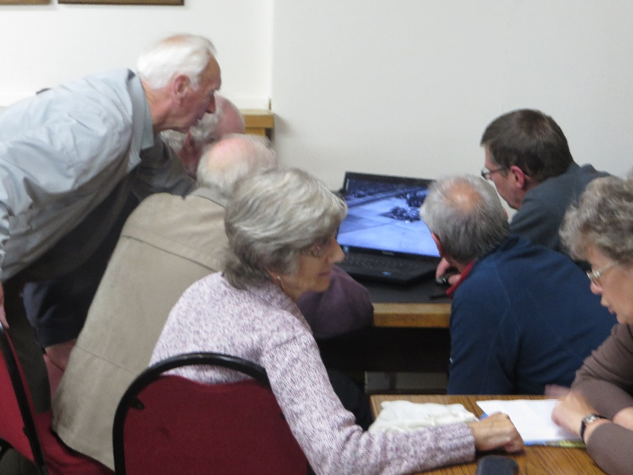
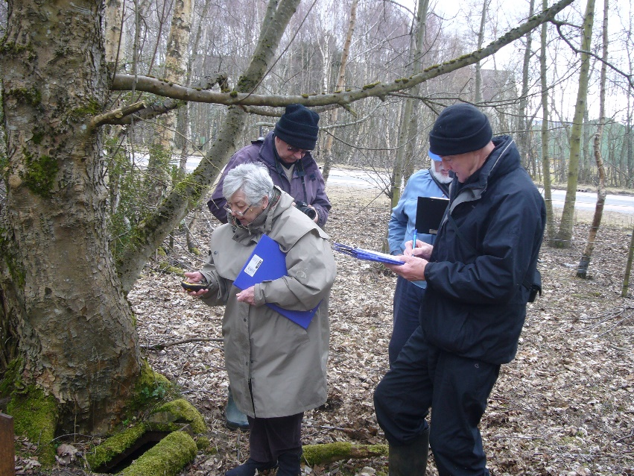
Why?
Many people want structured ‘projects’
Helps with organisation sustainability
Helps preserve some of our heritage assets
Gives participants transferable skills
It’s fun and inspiring, and a good way for people to connect

Slide 4
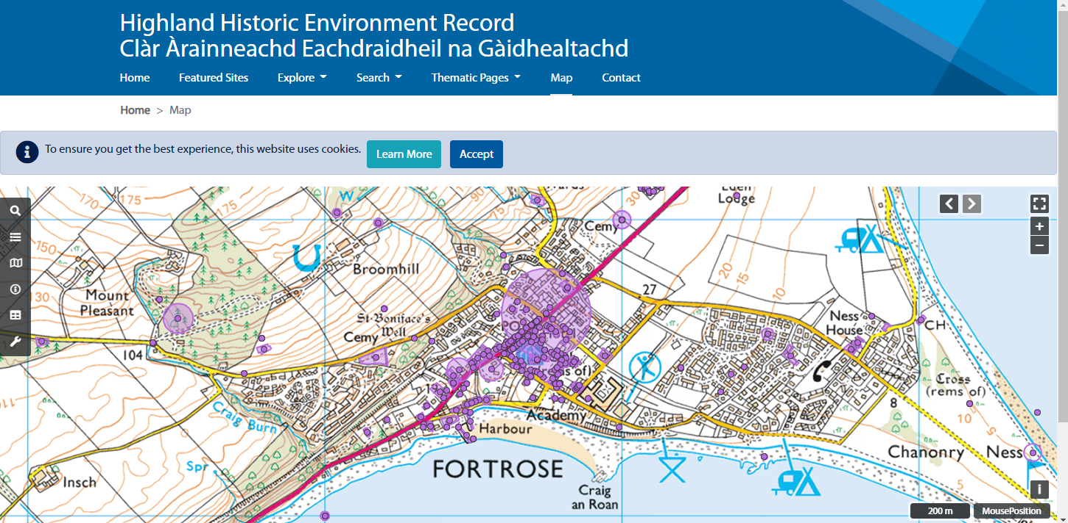
Some useful starting points
her.highland.gov.uk

Slide 5
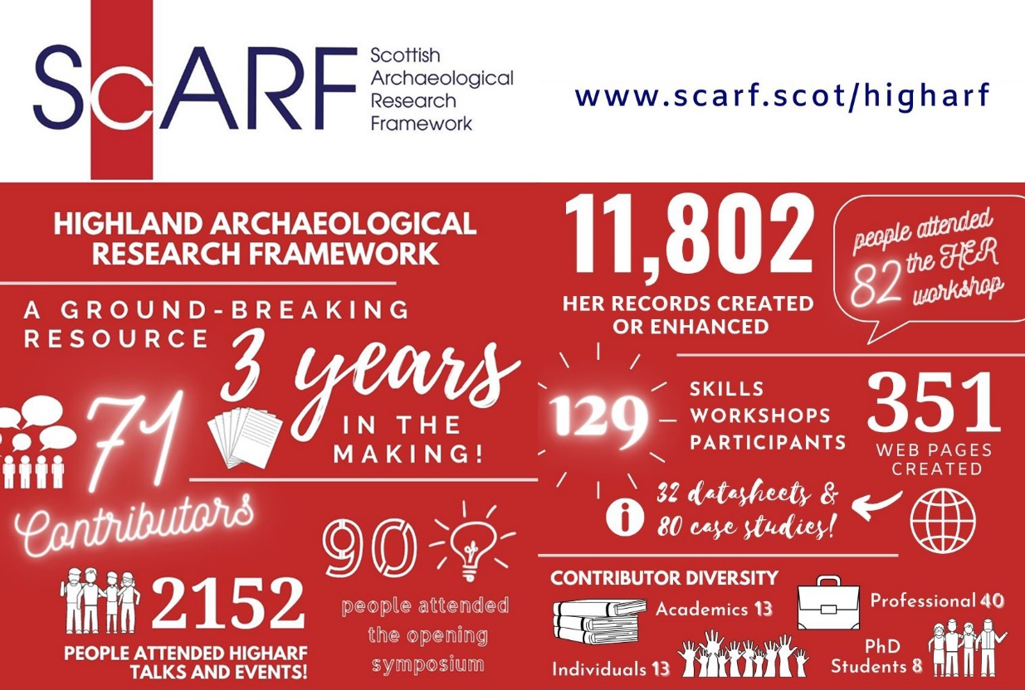
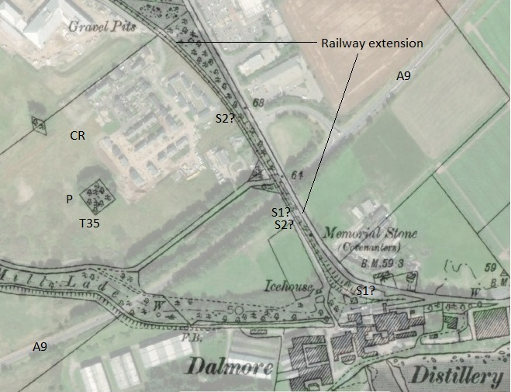
https://scarf.scot/regional/higharf/
maps.nls.uk

Slide 6
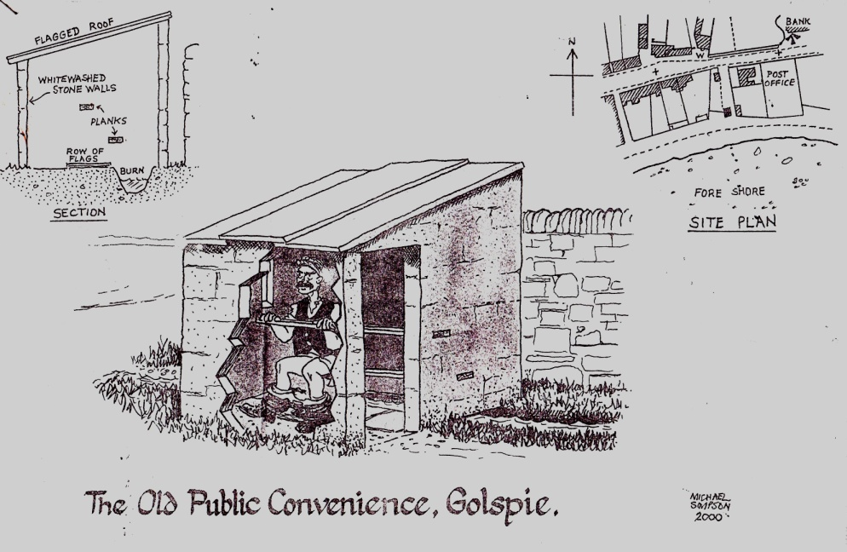
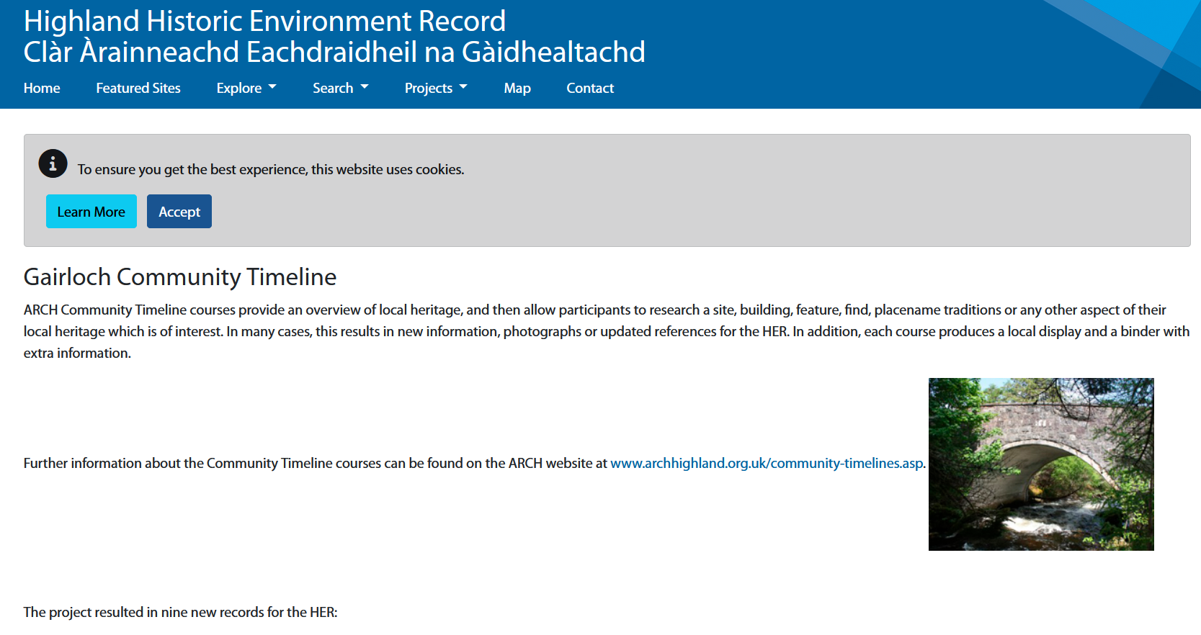
How?
Lots of different ways, but should aim to:
be accessible (physically and mentally)
avoid financial barriers
if possible take place in community
take advantage of expertise brought by participants
Run yourself or hire someone to do it?
Ensure that any results are put into the public domain

Slide 7
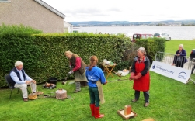
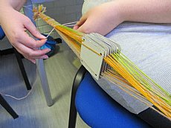
Reaching ‘not the usual suspects’
Essential for NLHF applications
Links to other clubs (eg photography, creative writing, arts)
Potential: hill walkers, dog walkers
Example: Wick Museum outreach to B&B operators

Slide 8
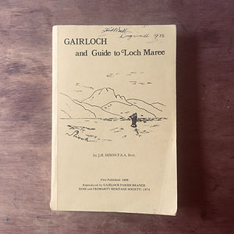
Example: a series of small events organised by Gairloch Museum
Lecture series
Weekly Warm Winter Wednesdays drop in, with lunch, crafting activities, board games
Ceilidh House get-together
Regular book group, exploring Dixon’s Gairloch and Guide to Loch Maree
Monthly Book Group
Craft workshops
Creative Writing Group

Slide 9
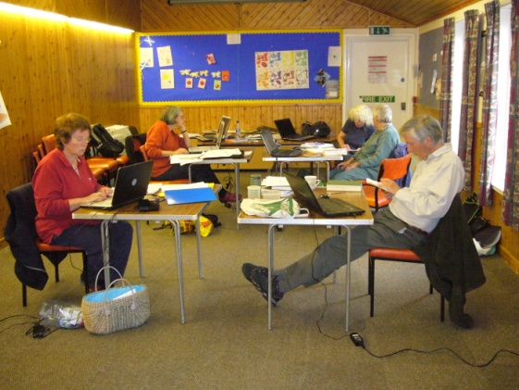
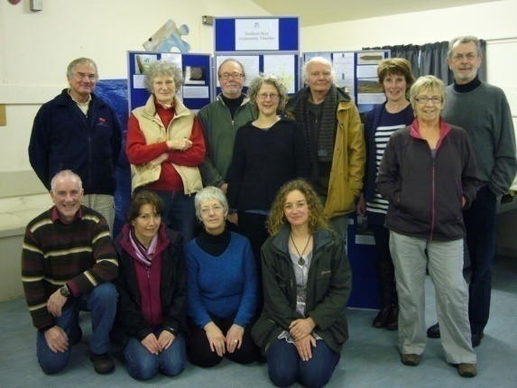
Example: ARCH Community Timelines
A great way to encourage people to explore local communities
3 main modules:
Oral history
Research
Creating outputs including displays

Slide 10
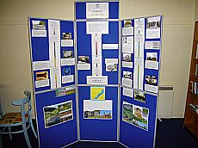
Community Timeline Courses
Golspie
Evanton
Auldearn
Tomatin
Fort Augustus to Fort William
Gairloch area
Boat of Garten
Broadford
Strathpeffer
Ardersier
Hilton
Knockbain (Black Isle)
Ardross
Kirkhill Parish

Slide 11
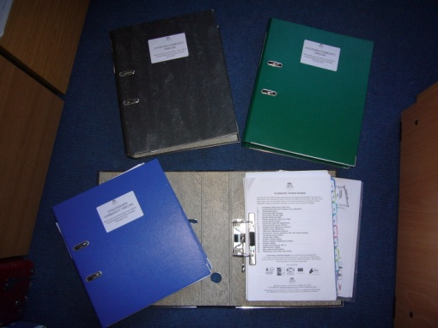
Community Timelines
Very popular
Multi-period
Huge amounts of information
Digital and paper outputs
Can lead to new groups, or new volunteering
Guidance on running modules on the ARCH website

Slide 12
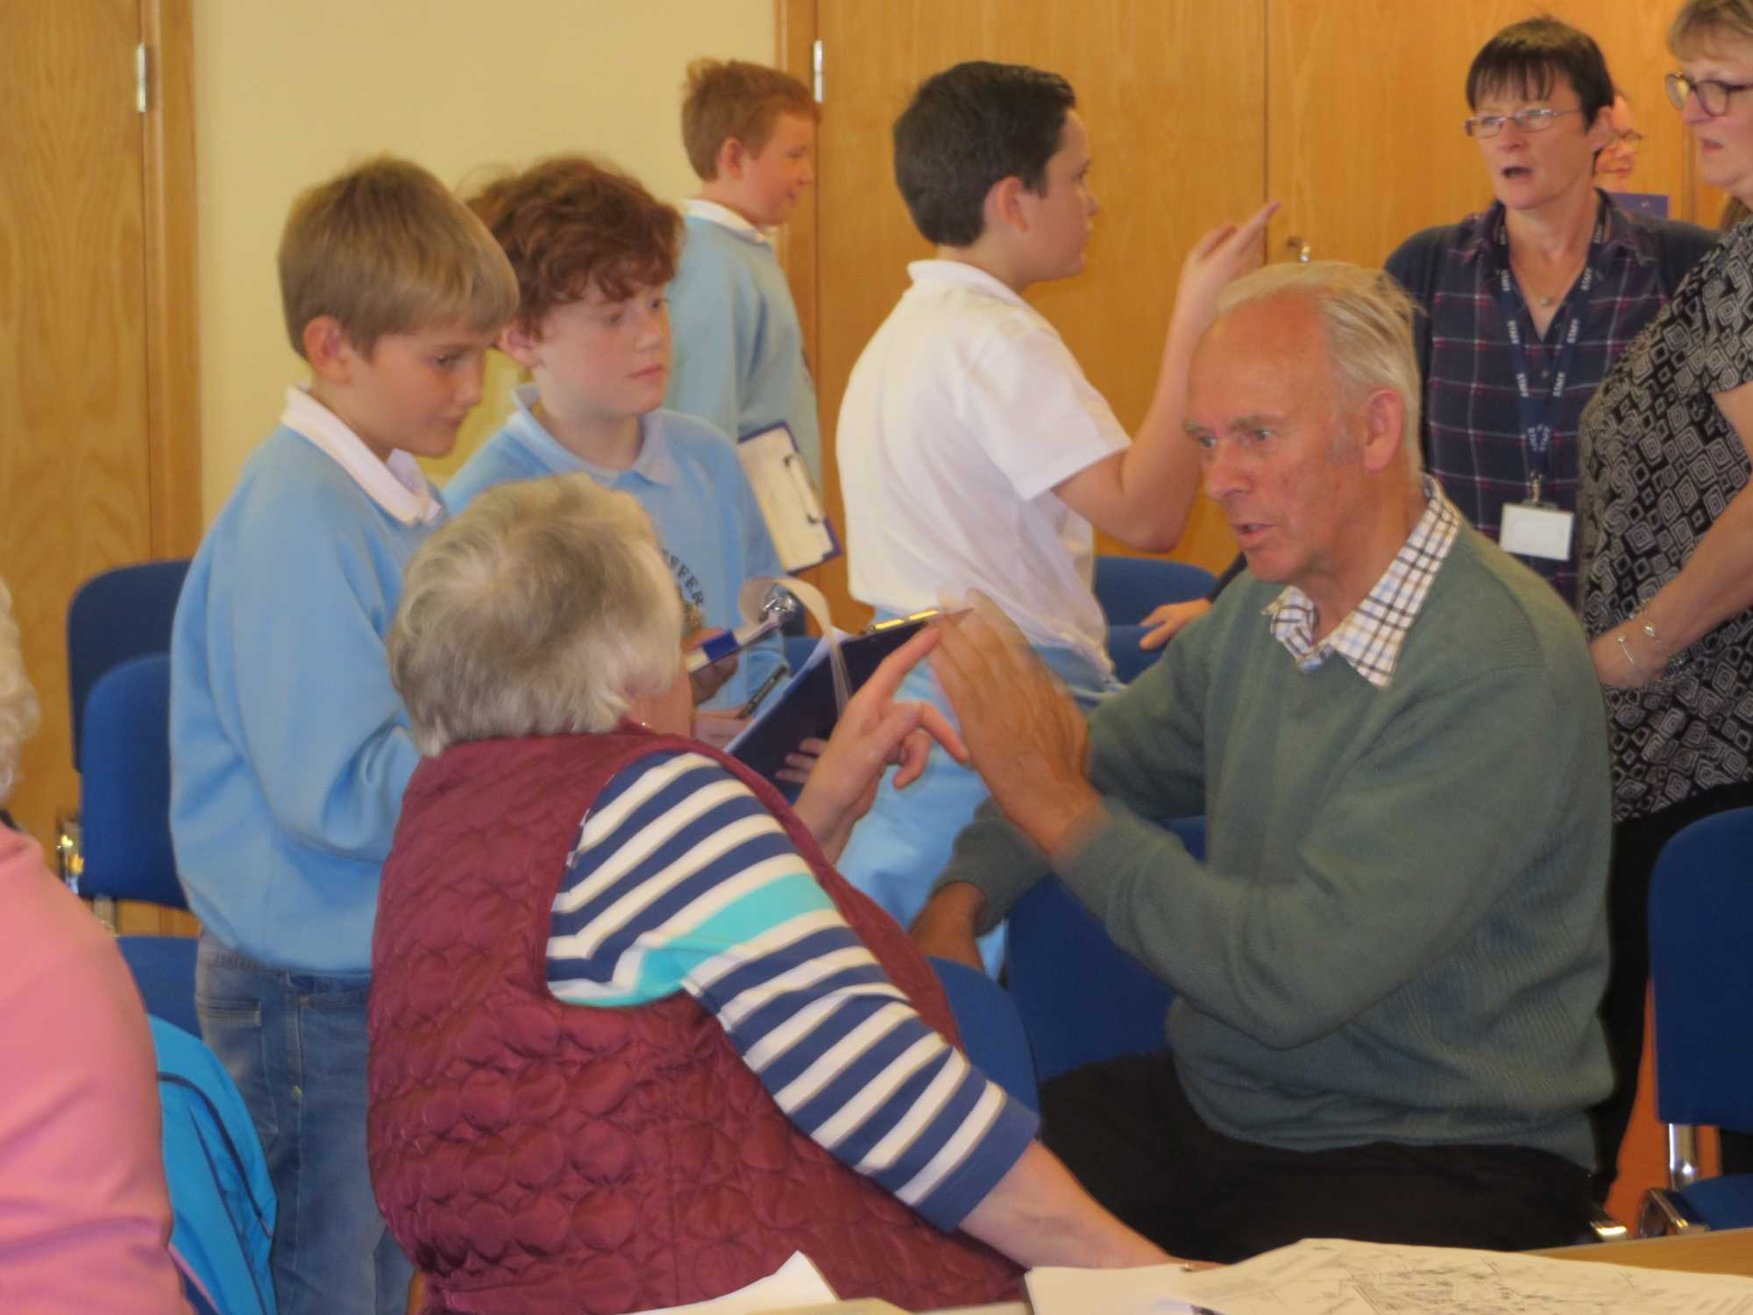
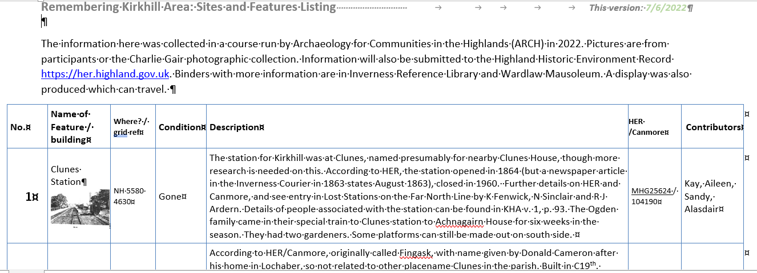
Module: Oral History
Five 2.5 hour sessions
Low tech – scribing rather than recording
Group sessions
A great way to start any project – can bring in people who do not think they are interested in heritage
Transcript which grows each week
Brings together old and new residents
Tea break very important!

Slide 13
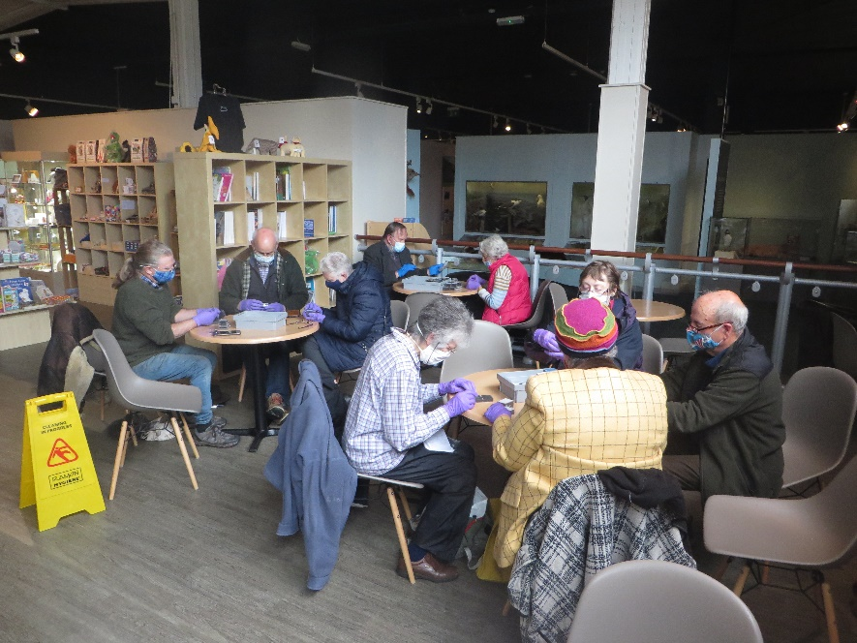
Module: Researching
Six 2.5 hour sessions
Leads on from questions in oral history module
(Optional) sessions at archives, local museums, or library, trips outside to visit sites
Sessions showing HER and NLS maps
Information added to oral history transcript and for binder
Lends itself to groupwork

Slide 14
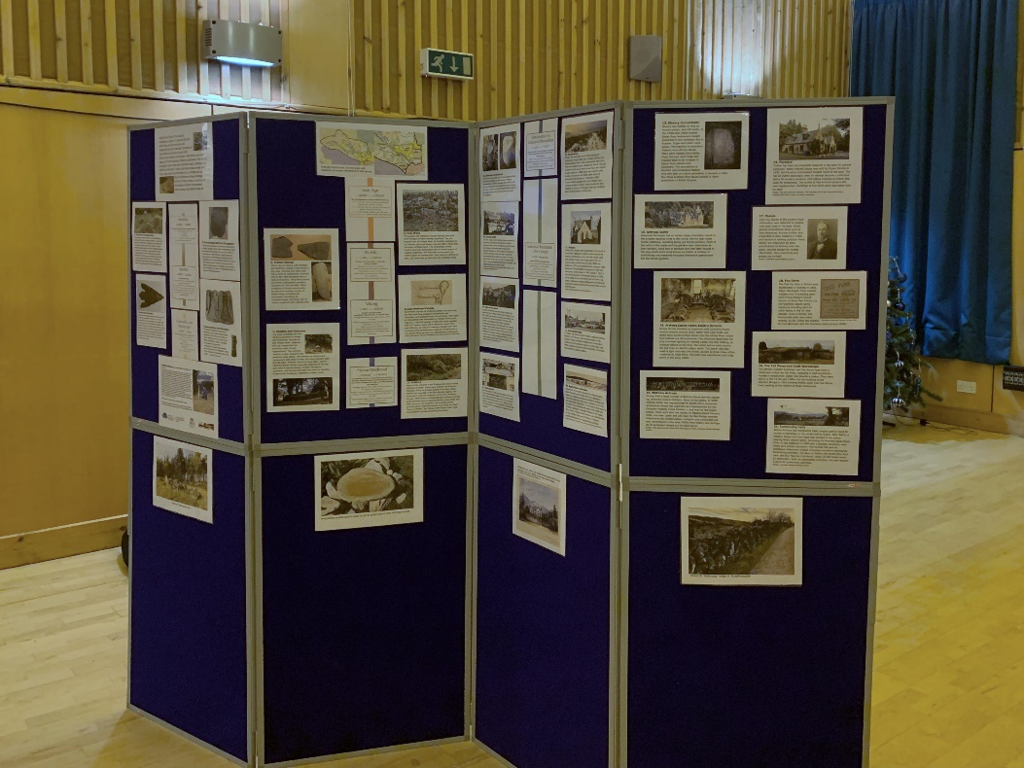
Module: Creating a Display and Binder
Five 2.5 hour sessions
Group identifies key research points, ideally spread over time period
Honing research to 50-100 words per topic!
Anything extra goes in binder
Good for local museums, providing skills

Slide 15
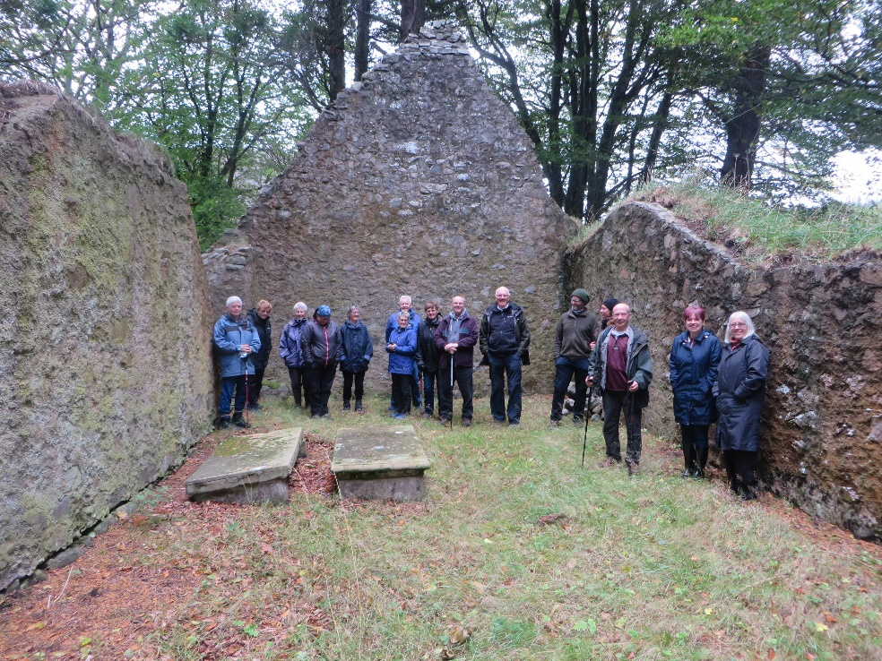
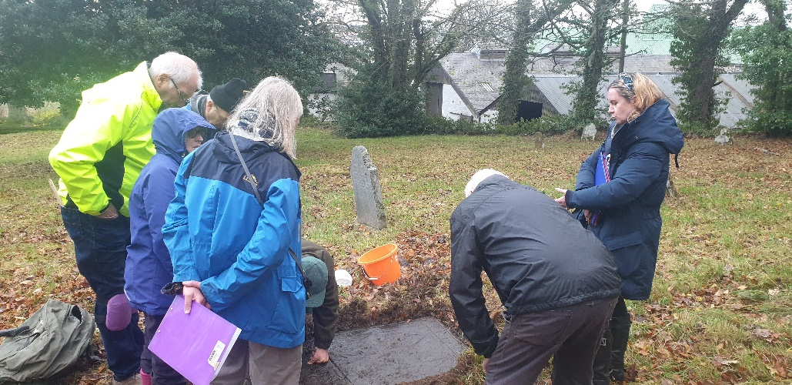
Example: Ardross Community Council area
Rural community, with a range of prehistoric sites (chambered cairns, BA metalworking, Pictish stones)
Attracted over 50 local and former residents (10 not on internet)
The joy of meeting up after Covid
Wealthy landowners (from opium, bread, condiments and cloth) in the past have shaped much of the area

Slide 16
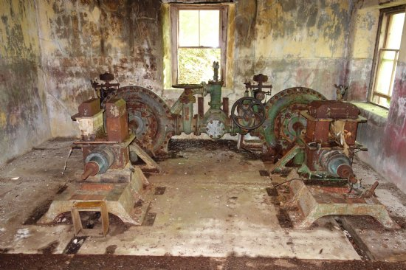
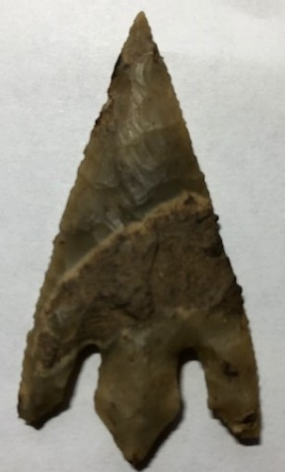
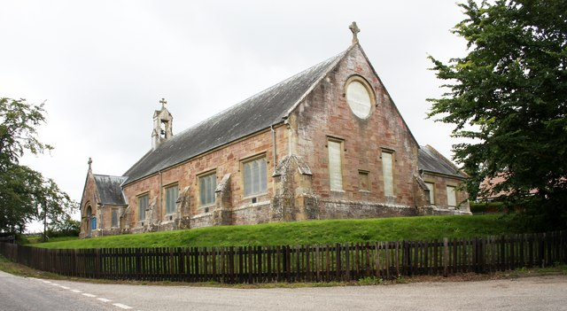
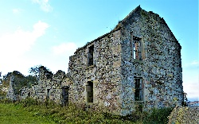
Ardross Surprises
An amazing hydro system
The first fox farm in Britain
Some new prehistoric finds
A large number of memories and photos of various sites including the Ardross Smithy, Stittenham House, Newfie camps
Ardross Church
Old routeways
Boardwalks, March stones etc
Some important buildings not yet in HER (eg Lealty)

Slide 17
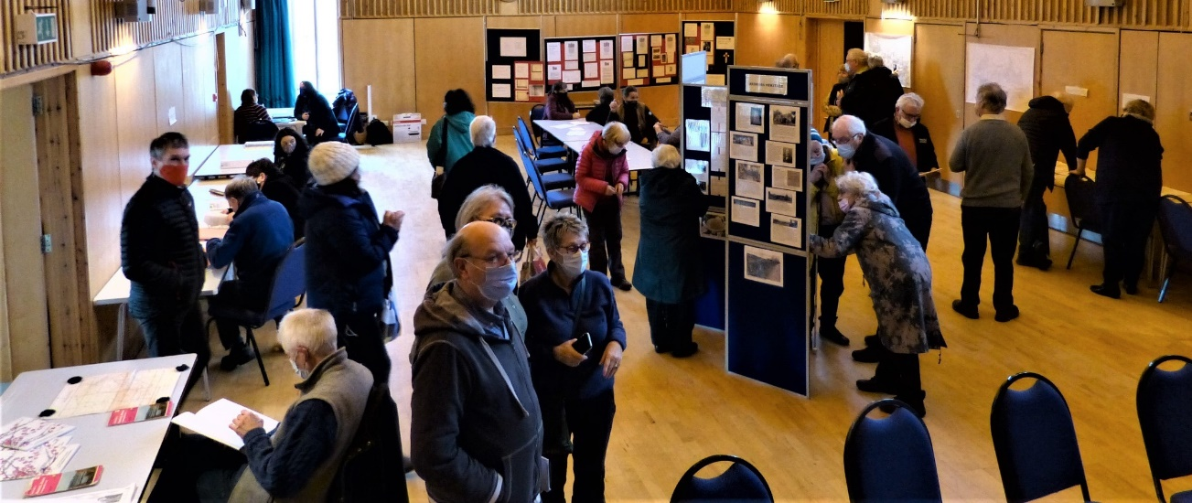
“The ‘Community Timeline’ module is now tried and tested, and provides amazing results at relatively small cost, with the outputs contributing to important information for the historic environment, reinforcing a sense of community and place. Every community has such a project crying out to be done, and with trained facilitators could be rolled out widely with important beneficial results.”

Slide 18
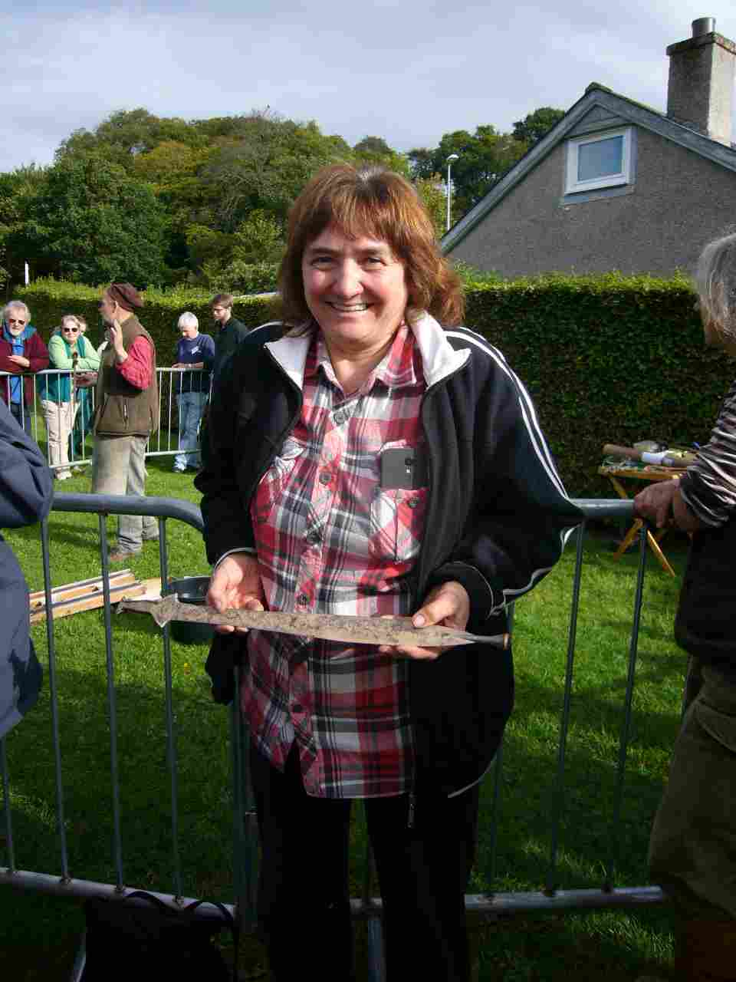
Over to you …
Examples of community outreach which were successful
Examples which did not work
How did you manage to get ‘non heritage’ people involved?
What were the main gains for your organisation?

